Slide 1
Large-scale Inverse Modeling of Hydraulic Tomography by Physics Informed Neural Network
Presenter: Quan Guo
Advisor: Prof. Jian Luo
Civil and Environmental Engineering
Georgia Institute of Technology
December 2022
Notes:
Hello, everyone, my name is Quan, I am a PhD student from Georgia Tech Civil Engineering. My advisor is Prof. Jian Luo and our group focus on groundwater inverse modeling with geostatistical and machine learning approach. Today I am very honored to introduce my work about applying physics-informed neural network to inverse modeling of hydraulic tomography.

Slide 2
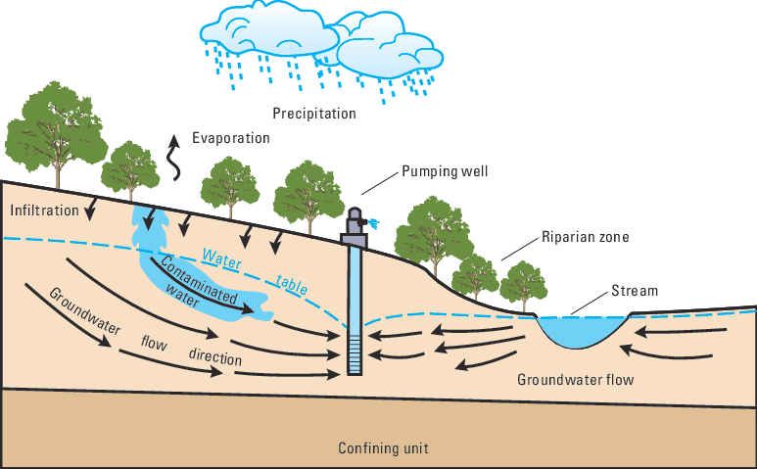
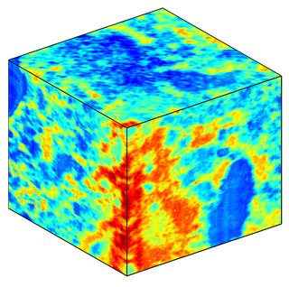
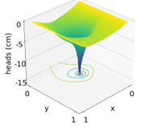
Groundwater Pumping Test
Pumping test is widely used to investigate porous media property and simulate groundwater (GW) flow.
Porous media
Hydraulic heads
Notes:
Hydraulic tomography is conducting sequential pumping tests in porous media and observe the responses of hydraulic heads. It is widely used for characterizing conductivity or transmissivity of the porous media.

Slide 3
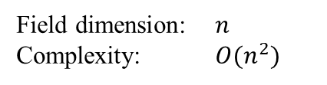
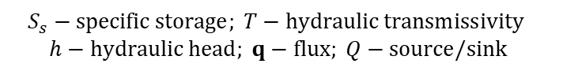
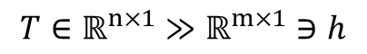
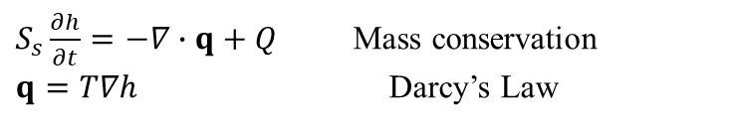
GW Forward and Inverse Problem
parameterized PDEs
Forward model is numerical method, e.g., finite element method (FEM)
forward problem
Field dimension: $n$
Complexity: $O(n^{2})$
Forward
$S_{s}\frac{∂h}{∂t}=−∇∙q+Q$ Mass conservation
$q=T∇h$ Darcy’s Law
$$T∈ℝ^{n×1}≫ℝ^{m×1}∋h$$
$$S_{s}−specific storage; T−hydraulic transmissivity$$
$$h−hydraulic head; q−flux; Q−source/sink$$
Inverse
non-linear and ill-posed
Gradient-based inverse methods iteratively run forward model to determine Jacobian matrix, etc.
Computationally expensive & non-scalable
inverse problem
(Zhao & Luo, 2020; Zhao & Luo, 2021a; Zhao & Luo, 2021b; Zhao et al., 2022)
Notes:
Correspondingly, the forward problem solves hydraulic heads with known transmissivity, and numerical method like FEM can be used as forward model. However, The inverse problem is characterizing transmissivity, it is ill-posed and nonlinear, many gradient-based methods need to run the forward model iteratively. Such methods are computationally expensive when the dimension of the transmissivity field is large.

Slide 4
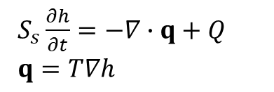
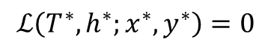
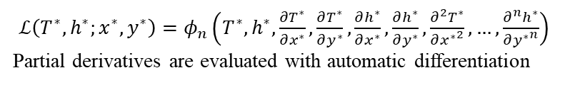
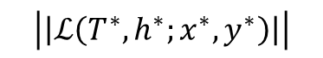
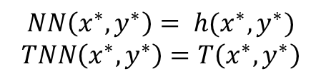
GW PINN Model
Groundwater PINNs
$$NN\left(x^{∗},y^{∗}\right)= h(x^{∗},y^{∗})$$
$$TNN\left(x^{∗},y^{∗}\right)=T\left(x^{∗},y^{∗}\right)$$
minimize
Loss of PDE regularization
$$\left|\left|ℒ\left(T^{∗},h^{∗};x^{∗},y^{∗}\right)\right|\right|$$
(Tartakovsky et al., 2020)
governs
soft constraint
Mass conservation
Darcy’s Law
$S_{s}\frac{∂h}{∂t}=−∇∙q+Q$
$q=T∇h$
formulate
$$ℒ\left(T^{∗},h^{∗};x^{∗},y^{∗}\right)=0$$
PDE residuals
$ℒ\left(T^{∗},h^{∗};x^{∗},y^{∗}\right)=φ_{n}\left(T^{∗},h^{∗},\frac{∂T^{∗}}{∂x^{∗}},\frac{∂T^{∗}}{∂y^{∗}},\frac{∂h^{∗}}{∂x^{∗}},\frac{∂h^{∗}}{∂y^{∗}},\frac{∂^{2}T^{∗}}{∂{x^{∗}}^{2}},…,\frac{∂^{n}h^{∗}}{∂{y^{∗}}^{n}}\right)$
Partial derivatives are evaluated with automatic differentiation
(He & Tartakovsky, 2021; Raissi et al., 2019; Tartakovsky et al., 2020; Wang et al., 2021; Xu et al., 2021)
Notes:
Recently, Dr. Tartakovsky proposed to use physics informed neural networks in sub-flow modeling. In the work, there are two nets, one for hydraulic heads and the other for conductivity, they are combined to minimize the loss term of PDE regularization. This term is derived from sub-flow governing equations. The related partial derivatives are evaluated with automatic differentiation. Within the same framework, we use PINN to simulate the hydraulic tomography.
In 2017, Dr. Raissi proposed PINNs to solve PDE with neural networks.

Slide 5
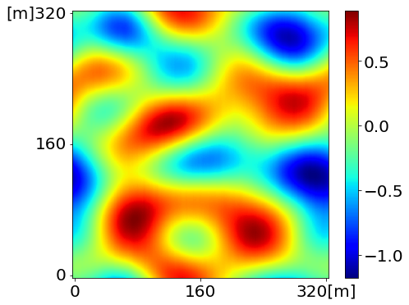
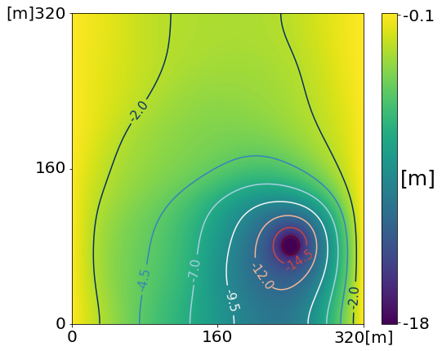
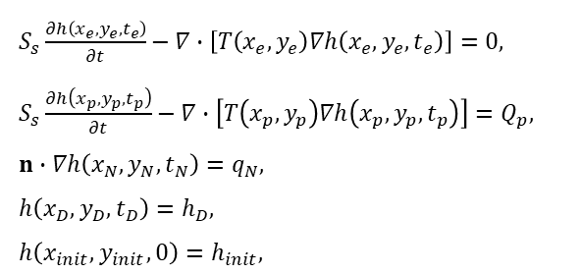
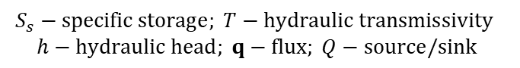
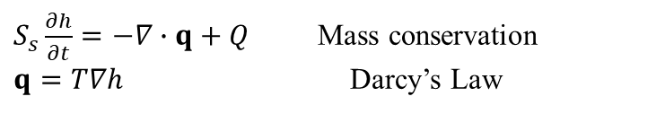
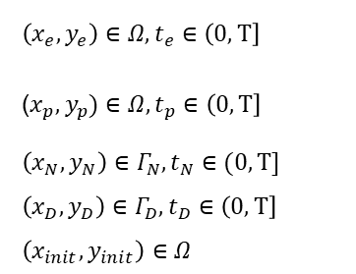
Physical Constraints of Pumping Test
Aquifer ($T$): 2D, 1024$×$1024, confined & saturated, isotropic
$S_{s}\frac{∂h}{∂t}=−∇∙q+Q$ Mass conservation
$q=T∇h$ Darcy’s Law
$$S_{s}−specific storage; T−hydraulic transmissivity$$
$$h−hydraulic head; q−flux; Q−source/sink$$
PLAN View
PDE for non-pumping grid
PDE for pumping grid
$S_{s}\frac{∂h\left(x_{e},y_{e},t_{e}\right)}{∂t}−∇∙\left[T\left(x_{e},y_{e}\right)∇h\left(x_{e},y_{e},t_{e}\right)\right]=0,$ $S_{s}\frac{∂h\left(x_{p},y_{p},t_{p}\right)}{∂t}−∇∙\left[T\left(x_{p},y_{p}\right)∇h\left(x_{p},y_{p},t_{p}\right)\right]=Q_{p},$ $n∙∇h\left(x_{N},y_{N},t_{N}\right)=q_{N},$ $h\left(x_{D},y_{D},t_{D}\right)=h_{D},$ $h\left(x_{init},y_{init},0\right)=h_{init},$
$\left(x_{e},y_{e}\right)∈Ω, t_{e}∈\left(0,T\right]$
($x_{p},y_{p})∈Ω, t_{p}∈\left(0,T\right]$
$\left(x_{N},y_{N}\right)∈Γ_{N},t_{N}∈(0,T]$
$\left(x_{D},y_{D}\right)∈Γ_{D}, t_{D}∈\left(0,T\right]$
$\left(x_{init},y_{init}\right)∈Ω$
Neumann Boundary Condition
Dirichlet Boundary Condition
Initial Condition
(Guo et al., 2022)
Notes:
In the simulation, the aquifer is 2D, the resolution is1024x1024, containing over 1 million unknowns. The system of pumping test has 5 PDEs, including initial and boundary conditions and governing equations for non-pumping grid and pumping well. The two governing equations have the same form but are different the right-hand side by the pumping rate.
Pumping grid is a sink to the system.

Slide 6
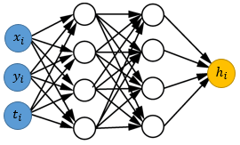
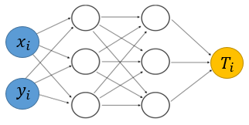
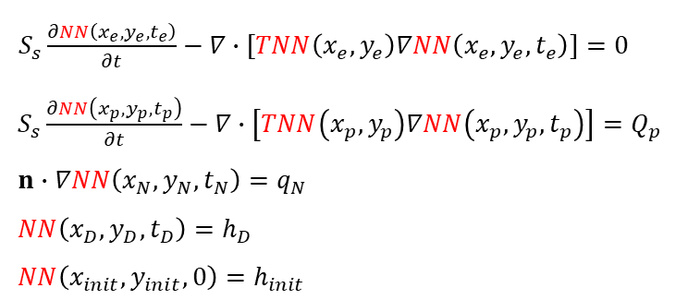
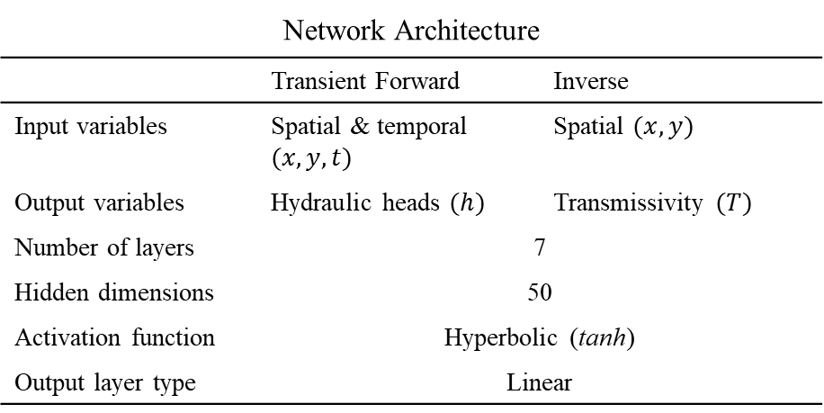
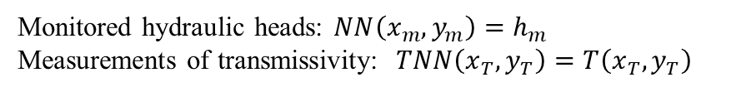
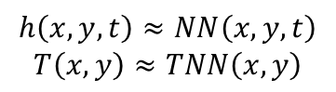
Network Structure
Forward Net
Inverse Net
DNN model:
$$h\left(x,y,t\right)≈NN\left(x,y,t\right)$$
$$T\left(x,y\right)≈TNN\left(x,y\right)$$
Data (reference):
Monitored hydraulic heads: $NN\left(x_{m},y_{m}\right)=h_{m}$
Measurements of transmissivity: $TNN\left(x_{T},y_{T}\right)=T\left(x_{T},y_{T}\right)$
Network Architecture
 | Transient Forward | Inverse
Input variables | Spatial & temporal $(x,y,t)$ | Spatial $(x,y)$
Output variables | Hydraulic heads $(h)$ | Transmissivity $(T)$
Number of layers | 7
Hidden dimensions | 50
Activation function | Hyperbolic (tanh)
Output layer type | Linear
Regularization (collocation):
$S_{s}\frac{∂NN\left(x_{e},y_{e},t_{e}\right)}{∂t}−∇∙[TNN\left(x_{e},y_{e}\right)∇NN\left(x_{e},y_{e},t_{e}\right)]=0$ $S_{s}\frac{∂NN\left(x_{p},y_{p},t_{p}\right)}{∂t}−∇∙\left[TNN\left(x_{p},y_{p}\right)∇NN\left(x_{p},y_{p},t_{p}\right)\right]=Q_{p}$ $n∙∇NN\left(x_{N},y_{N},t_{N}\right)=q_{N}$ $NN\left(x_{D},y_{D},t_{D}\right)=h_{D}$ $NN\left(x_{init},y_{init},0\right)=h_{init}$
(Guo et al., 2022)
Notes:
We use two neural networks for simulating a pumping test. Forward net takes spatial and temporal coordinates as input and predict hydraulic head as output. Inverse net takes spatial coordinate as input and estimate transmissivity as output. We collect labeled reference data for both of networks at measuring locations. Besides, two nets are forced to satisfy the PDE constraints at collocation points.

Slide 7
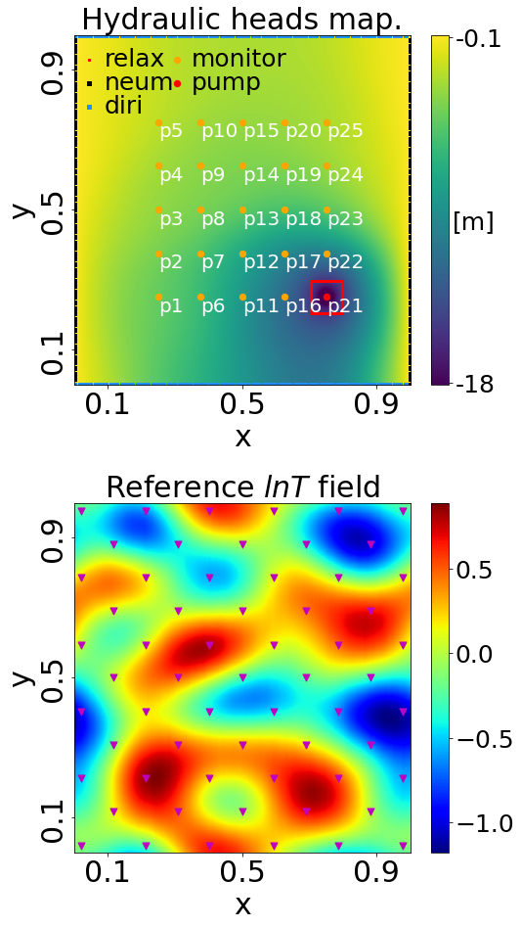
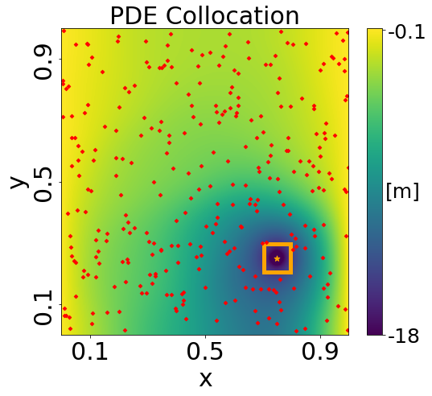
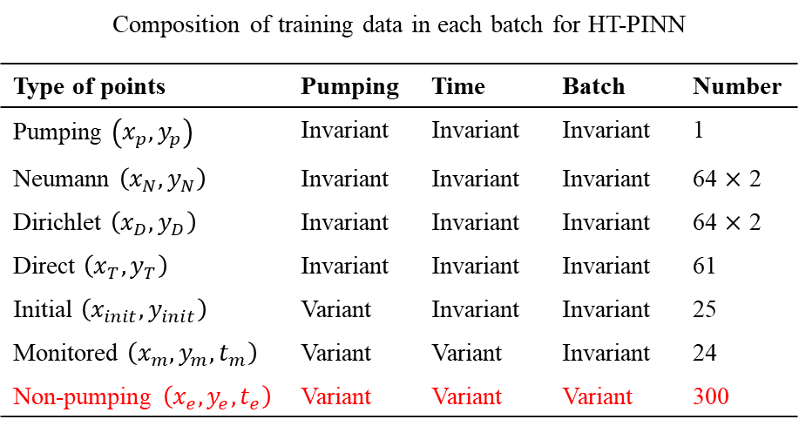
Data Batch Sampling
Collocation Data
Composition of training data in each batch for HT-PINN
Type of points | Pumping | Time | Batch | Number
Pumping $\left(x_{p}, y_{p}\right)$ | Invariant | Invariant | Invariant | 1
Neumann $\left(x_{N},y_{N}\right)$ | Invariant | Invariant | Invariant | 64 $×$ 2
Dirichlet $\left(x_{D},y_{D}\right)$ | Invariant | Invariant | Invariant | 64 $×$ 2
Direct $\left(x_{T},y_{T}\right)$ | Invariant | Invariant | Invariant | 61
Initial $\left(x_{init},y_{init}\right)$ | Variant | Invariant | Invariant | 25
Monitored $\left(x_{m},y_{m},t_{m}\right)$ | Variant | Variant | Invariant | 24
Non-pumping $\left(x_{e},y_{e},t_{e}\right)$ | Variant | Variant | Variant | 300
Reference
Data
Deterministic
Random
BC, IC,
pumping,
reference
Non-pumping
+
=
Data Batch
(Guo et al., 2022)
Notes:
The measurements and collocation data for training are sampled in batch, at each time step in a pumping test, we sample 10 batch of data. Within these batch, most data are deterministic except for the non-pumping grids. Non-pumping grids are randomly selected from the domain, the number of them is a hyperparameter like batch size in deep learning.
Deterministic data include reference data and boundary and initial conditions and pumping grid.

Slide 8
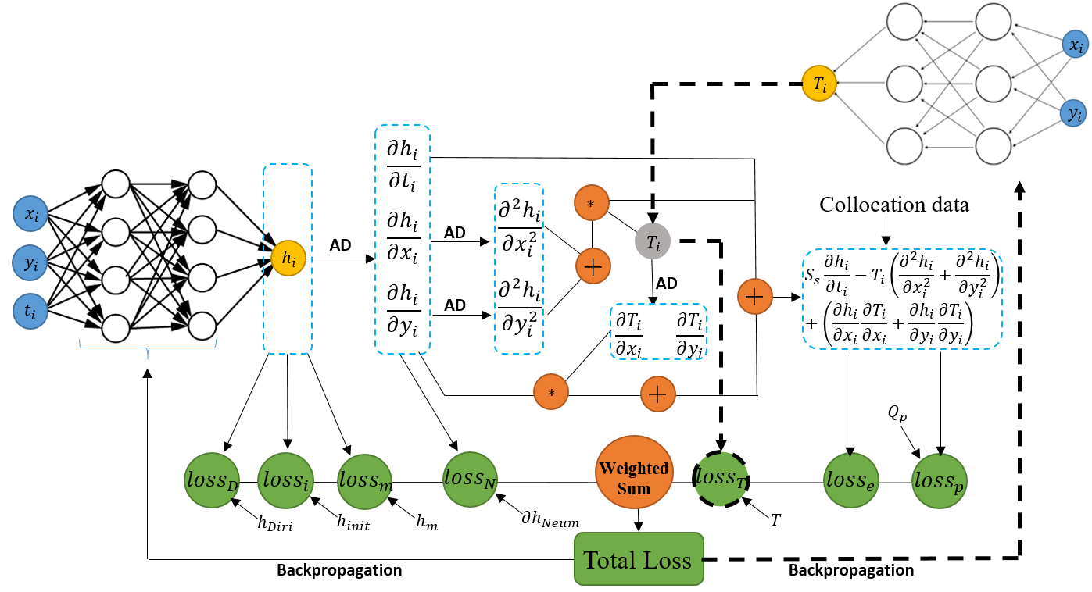
PINN for Transient Pumping Test
(Guo et al., 2022)
Notes:
This is the graph of PINN for pumping test. In each training iteration, a batch of data is used to train the PINN. The predictions from two nets are used for evaluating loss of data match and zero-order constraints like constant-head initial condition and Dirichlet BC. Then, automatic differentiation is applied to compose the higher-order PDE loss terms. Total loss is weighted sum of all these loss terms. It is optimized through backpropagation.

Slide 9
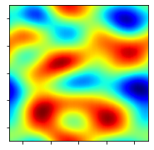
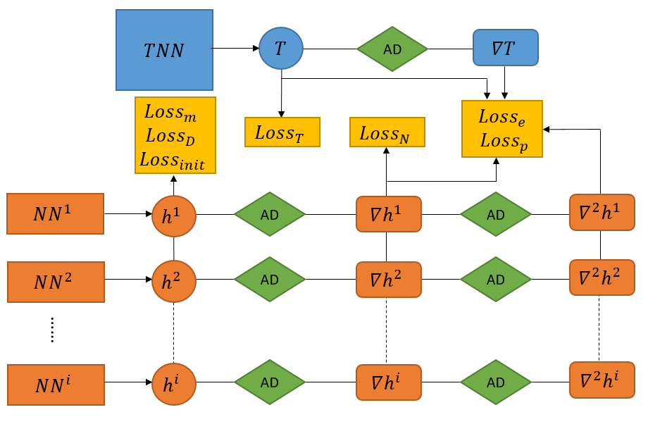
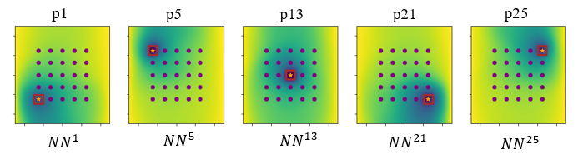
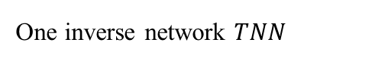
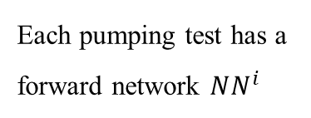
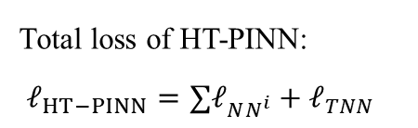
Hydraulic Tomography - PINN
One inverse network $TNN$
Total loss of HT-PINN:
$ℓ_{HT−PINN}=∑ℓ_{NN^{i}}+ℓ_{TNN}$
Each pumping test has a forward network $NN^{i}$
(Guo et al., 2022)
Notes:
In hydraulic tomography, sequential pumping tests are conducted at different locations. Each of them is a specific forward problem and is simulated by an individual forward net. The inverse net is unchanged. Multiple nets can be trained together to provide stronger PDE constraints. And this is full hydraulic tomography PINN or HT-PINN.

Slide 10
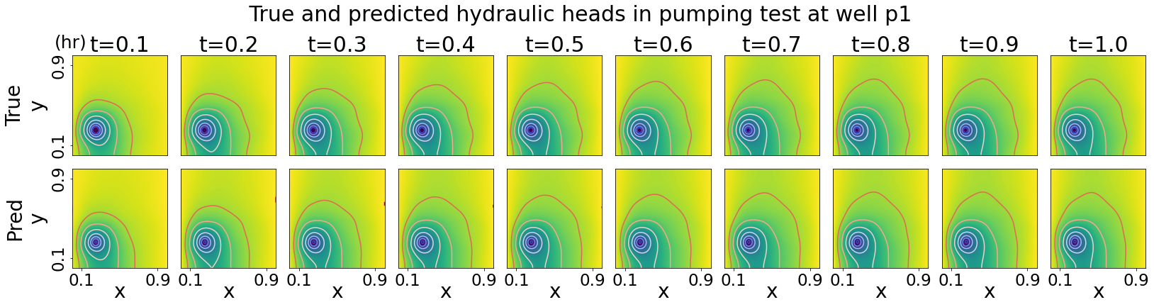
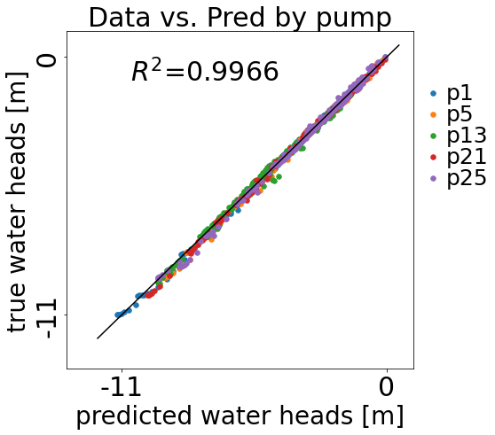
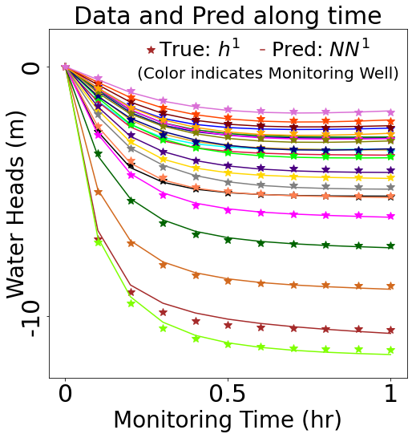
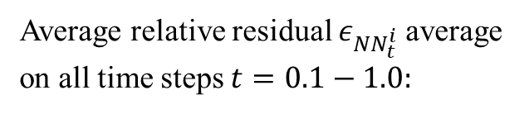
Transient Forward Prediction
Average relative residual $ε_{NN_{t}^{i}}$ average on all time steps $t=0.1−1.0:$
P1: 6.14%
P5: 6.26%
P13: 6.23%
P21: 6.58%
P25: 6.53%
(Guo et al., 2022)
Notes:
Let’s see the simulation results. Here is the performance of forward net. The bottom two figures are comparison between model prediction and reference data at specific location. The top figure shows the reference solution from FEM and prediction from forward net of the entire domain at different time steps. The evaluation metrics is relative residual, the result of each pumping test is around 6%.
They match very well including defined boundary condition.

Slide 11
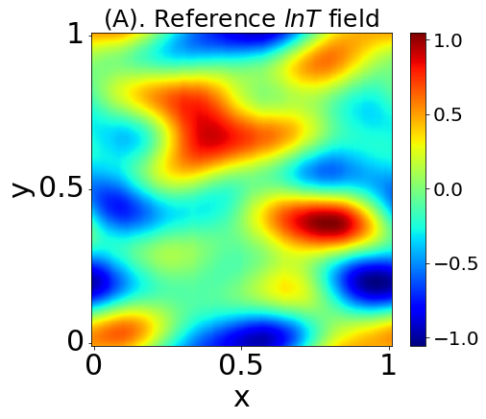
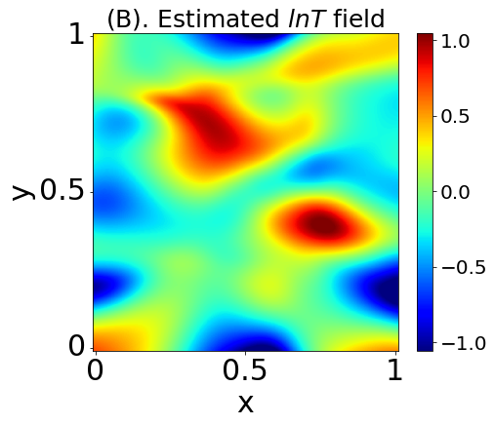
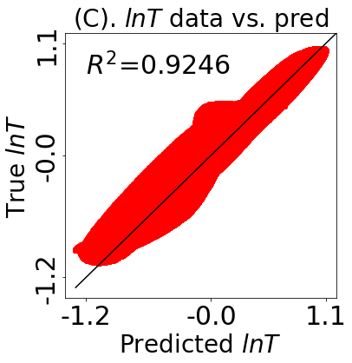
Inverse Estimation
The relative residual $ε_{TNN}$ is 10.32%, and the accuracy is 94.93%.
Training time is about 9.5 hours.
(Guo et al., 2022)
Notes:
Here is the result of inverse net, (A) is the reference field and (B) is the estimation from the inverse net. (C) is the comparison between them. The accuracy of the estimation is around 95%.

Slide 12
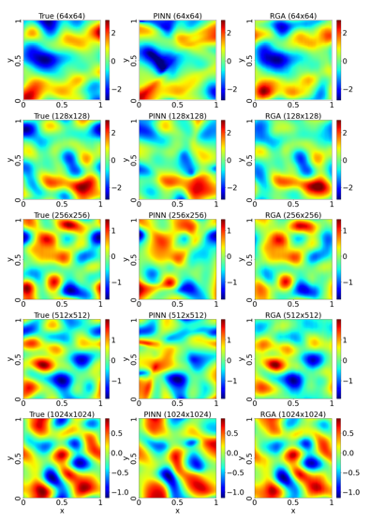
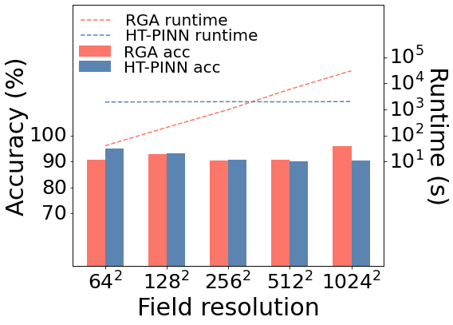
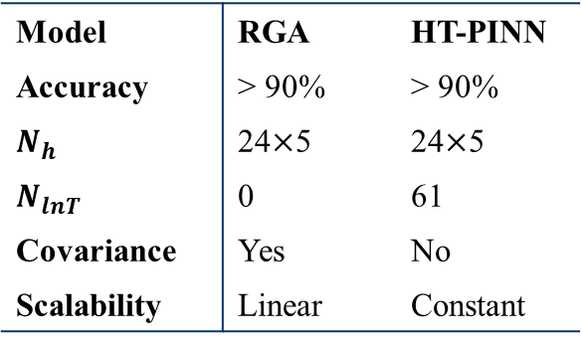
Model Scalability
Model | RGA | HT-PINN
Accuracy | > 90% | > 90%
$N_{h}$ | 24$×$5 | 24$×$5
$N_{lnT}$ | 0 | 61
Covariance | Yes | No
Scalability | Linear | Constant
Future improvements:
Data efficiency: reduce amount of reference data
Generalizability: applicable to non-Gaussian field
(Guo et al., 2022)
Notes:
We investigate scalability of HT-PINN through inversing field of different resolutions. The runtime is compared with a gradient-based model called RGA. Training time of HT-PINN is constant of all tests since it is a pointwise deep learning model and training time only depends on the batch size and number of training iterations. On the other hand, runtime of RGA is about linearly increasing because it needs to run the forward model iteratively to approximate the gradient. This results shows that PINN can be used for high-dimensional inverse problem. In future, we want to improve HT-PINN to be more data efficient and generalizable which requires smaller amount of reference data and can be applicable to non-Gaussian field.
With inspirations from other excellent models like TgNN-Geo, PI-CKLE or Geo-GAN.

Slide 13
Many thanks for your time!
Appreciate any questions
Acknowledgements: thanks many peers for sharing their work of applying machine learning to subsurface modeling where we get inspirations and guidance from, especially Dr. A.M, Tartakovsky, Dr. D, Zhang, Dr. N, Wang, Dr. Q, He, Dr. E, Laloy, Dr. R, Xu, etc.
Notes:
Thanks very much for your time! Very glad to answer your questions.

Slide 14
Reference
Bandai, T., & Ghezzehei, T. A. (2021), Physics-Informed Neural Networks With Monotonicity Constraints for Richardson-Richards Equation: Estimation of Constitutive Relationships and Soil Water Flux Density From Volumetric Water Content Measurements, Water Resources Research, 57(2), e2020WR027642.
Bottou, L., & Bousquet, O. (2008), The tradeoffs of large scale learning, Adv. Neur. In, 20, 161-168.
Broyden, C. G. (1965), A class of methods for solving nonlinear simultaneous equations, Math. Comput., 19(92), 577-593.
Cardiff, M., Barrash, W., & Kitanidis, P. K. (2013), Hydraulic conductivity imaging from 3-D transient hydraulic tomography at several pumping/observation densities, Water Resour. Res., 49(11), 7311-7326.
Carrera, J., & Neuman, S. P. (1986), Estimation of Aquifer Parameters Under Transient and Steady State Conditions: 1. Maximum Likelihood Method Incorporating Prior Information, Water Resources Research, 22(2), 199-210.
Cheng, S., Cheng, L., Qin, S., Zhang, L., Liu, P., Liu, L., Xu, Z., & Wang, Q. (2022), Improved Understanding of How Catchment Properties Control Hydrological Partitioning Through Machine Learning, Water Resources Research, 58(4), e2021WR031412.
Cho, E., Jacobs, J. M., Jia, X., & Kraatz, S. (2019), Identifying Subsurface Drainage using Satellite Big Data and Machine Learning via Google Earth Engine, Water Resources Research, 55(10), 8028-8045.
Fienen, M. N., Clemo, T., & Kitanidis, P. K. (2008), An interactive Bayesian geostatistical inverse protocol for hydraulic tomography, Water Resources Research, 44(12).
Goldberg, Y. (2016), A primer on neural network models for natural language processing, J. Artif. Int. Res., 57(1), 345–420.
Goldstein, E. B., & Coco, G. (2014), A machine learning approach for the prediction of settling velocity, Water Resources Research, 50(4), 3595-3601.
Griewank, A. (2003), A mathematical view of automatic differentiation, Acta Numer., 12, 321-398.
Guo, Q., Zhao, Y., Lu, C., Luo, J., 2022. High-dimensional inverse modeling of hydraulic tomography by physics informed neural network (HT-PINN). J. Hydrol., 128828. DOI:https://doi.org/10.1016/j.jhydrol.2022.128828
He, Q., & Tartakovsky, A. M. (2021), Physics-Informed Neural Network Method for Forward and Backward Advection-Dispersion Equations, Water Resources Research, 57(7), e2020WR029479.
He, Q., Barajas-Solano, D., Tartakovsky, G., & Tartakovsky, A. M. (2020a), Physics-informed neural networks for multiphysics data assimilation with application to subsurface transport, Advances in Water Resources, 141, 103610.
He, Q., Barajas-Solano, D., Tartakovsky, G., & Tartakovsky, A. M. (2020b), Physics-informed neural networks for multiphysics data assimilation with application to subsurface transport, Adv. Water Resour., 141, 103610.
Hoffer, E., Hubara, I., & Soudry, D. (2018), Train longer, generalize better: closing the generalization gap in large batch training of neural networks, arXiv.
Hofmann, T. (2004), Latent semantic models for collaborative filtering, ACM Trans. Inf. Syst., 22(1), 89-115.
Ioffe, S., & Szegedy, C. (2015), Batch Normalization: Accelerating Deep Network Training by Reducing Internal Covariate Shift, in Proceedings of the 32nd International Conference on Machine Learning, edited by B. Francis and B. David, pp. 448--456, PMLR, Proceedings of Machine Learning Research.
Jacob, Dillavou, S., Stern, M., Andrea, & Douglas (2022), Learning Without a Global Clock: Asynchronous Learning in a Physics-Driven Learning Network, arXiv.
(Guo et al., 2022)

Slide 15
Reference
Jagtap, A. D., Kharazmi, E., & Karniadakis, G. E. (2020), Conservative physics-informed neural networks on discrete domains for conservation laws: Applications to forward and inverse problems, Comput. Methods Appl. Mech. Eng., 365, 113028.
Kang, P. K., Lee, J., Fu, X., Lee, S., Kitanidis, P. K., & Juanes, R. (2017), Improved characterization of heterogeneous permeability in saline aquifers from transient pressure data during freshwater injection, Water Resour. Res., 53(5), 4444-4458.
Karniadakis, G. (2019), VPINNs: Variational physics-informed neural networks for solving partial differential equations, arXiv.
Kharazmi, E., Zhang, Z., & Karniadakis, G. E. M. (2021), hp-VPINNs: Variational physics-informed neural networks with domain decomposition, Comput. Methods Appl. Mech. Eng., 374, 113547.
Kingma, D. P., & Ba, J. (2017), Adam: A Method for Stochastic Optimization, arXiv.
Kitanidis, P. K. (1995), Quasi-Linear Geostatistical Theory for Inversing, Water Resour. Res., 31(10), 2411-2419.
Kitanidis, P. K., & Vomvoris, E. G. (1983), A geostatistical approach to the inverse problem in groundwater modeling (steady state) and one-dimensional simulations, Water Resources Research, 19(3), 677-690.
Klein, O., Cirpka, O. A., Bastian, P., & Ippisch, O. (2017), Efficient geostatistical inversion of transient groundwater flow using preconditioned nonlinear conjugate gradients, Adv. Water Resour., 102, 161-177.
Krizhevsky, A., Sutskever, I., & Hinton, G. E. (2012), ImageNet classification with deep convolutional neural networks, paper presented at Adv. Neur. In.
Laloy, E., Hérault, R., Lee, J., Jacques, D., & Linde, N. (2017), Inversion using a new low-dimensional representation of complex binary geological media based on a deep neural network, Advances in water resources, 110, 387-405.
LeCun, Y., Bengio, Y., & Hinton, G. (2015), Deep learning, Nature, 521(7553), 436-444.
Lee, J., & Kitanidis, P. (2014), Large scale hydraulic tomography and joint inversion of head and tracer data using the Principal Component Geostatistical Approach (PCGA), Water Resour. Res., 50, 5410-5427.
Li, J., & Tartakovsky, A. M. (2022), Physics-informed Karhunen-Loéve and neural network approximations for solving inverse differential equation problems, J. Comput. Phys., 462, 111230.
Li, J., Wang, Z., Wu, X., Xu, C.-Y., Guo, S., Chen, X., & Zhang, Z. (2021), Robust Meteorological Drought Prediction Using Antecedent SST Fluctuations and Machine Learning, Water Resources Research, 57(8), e2020WR029413.
Li, M., Zhang, T., Chen, Y., & Smola, A. J. (2021), Efficient mini-batch training for stochastic optimization, ACM, 2014.
Liu, X., & Kitanidis, P. (2011), Large‐scale inverse modeling with an application in hydraulic tomography, Water Resour. Res., 47(2).
Liu, Y., Sun, W., & Durlofsky, L. (2019), A Deep-Learning-Based Geological Parameterization for History Matching Complex Models, Mathematical Geosciences, 51.
Masters, D., & Luschi, C. (2018), Revisiting Small Batch Training for Deep Neural Networks, arXiv.
McCandlish, S., Kaplan, J., Amodei, D., & OpenAi (2018), An Empirical Model of Large-Batch Training, arXiv.
Meyer, D., Grimmond, S., Dueben, P., Hogan, R., & van Reeuwijk, M. (2022), Machine Learning Emulation of Urban Land Surface Processes, Journal of Advances in Modeling Earth Systems, 14(3), e2021MS002744.
Neuman, S. P. (1980), A statistical approach to the inverse problem of aquifer hydrology: 3. Improved solution method and added perspective, Water Resources Research, 16(2), 331-346.
(Guo et al., 2022)

Slide 16
Reference
Nitish, Mudigere, D., Nocedal, J., Smelyanskiy, M., & Ping (2017), On Large-Batch Training for Deep Learning: Generalization Gap and Sharp Minima, arXiv.
Nowak, W., Tenkleve, S., & Cirpka, O. A. (2003), Efficient computation of linearized cross-covariance and auto-covariance matrices of interdependent quantities, Math. Geol., 35(1), 53-66.
Pang, G., D'Elia, M., Parks, M., & Karniadakis, G. (2020), nPINNs: Nonlocal physics-informed neural networks for a parametrized nonlocal universal Laplacian operator. Algorithms and applications, J. Comput. Phys., 422, 109760.
Rahmati, O., Naghibi, S. A., Shahabi, H., Bui, D. T., Pradhan, B., Azareh, A., Rafiei-Sardooi, E., Samani, A. N., & Melesse, A. M. (2018), Groundwater spring potential modelling: Comprising the capability and robustness of three different modeling approaches, Journal of Hydrology, 565, 248-261.
Raissi, M., Perdikaris, P., & Karniadakis, G. (2017a), Physics Informed Deep Learning (Part II): Data-driven Discovery of Nonlinear Partial Differential Equations, arXiv, abs/1711.10566.
Raissi, M., Perdikaris, P., & Karniadakis, G. (2017b), Physics Informed Deep Learning (Part I): Data-driven Solutions of Nonlinear Partial Differential Equations, arXiv, abs/1711.10561.
Raissi, M., Perdikaris, P., & Karniadakis, G. E. (2019), Physics-informed neural networks: A deep learning framework for solving forward and inverse problems involving nonlinear partial differential equations, J. Comput. Phys., 378, 686-707.
Ren, P., Rao, C., Liu, Y., Wang, J.-X., & Sun, H. (2021), PhyCRNet: Physics-informed Convolutional-Recurrent Network for Solving Spatiotemporal PDEs.
Saibaba, A. K., Ambikasaran, S., Li, J. Y., Kitanidis, P. K., & Darve, E. F. (2012), Application of hierarchical matrices to linear inverse problems in geostatistics, Oil. Gas. Sci. Technol, 67(5), 857-875.
Shahnas, M. H., Yuen, D. A., & Pysklywec, R. N. (2018), Inverse Problems in Geodynamics Using Machine Learning Algorithms, J. Geophys. Res.: Solid Earth, 123(1), 296-310.
Snodgrass, M. F., & Kitanidis, P. K. (1998), Transmissivity identification through multi-directional aquifer stimulation, Stochastic Hydrology and Hydraulics, 12(5), 299-316.
Sun, A. Y., Scanlon, B. R., Save, H., & Rateb, A. (2021), Reconstruction of GRACE Total Water Storage Through Automated Machine Learning, Water Resources Research, 57(2), e2020WR028666.
Tahmasebi, P. (2017), HYPPS: A hybrid geostatistical modeling algorithm for subsurface modeling, Water Resources Research, 53(7), 5980-5997.
Tartakovsky, A. M., Marrero, C. O., Perdikaris, P., Tartakovsky, G. D., & Barajas-Solano, D. (2020), Physics-Informed Deep Neural Networks for Learning Parameters and Constitutive Relationships in Subsurface Flow Problems, Water Resour. Res., 56(5), e2019WR026731, doi: https://doi.org/10.1029/2019WR026731.
Vo, H. X., & Durlofsky, L. J. (2014), A New Differentiable Parameterization Based on Principal Component Analysis for the Low-Dimensional Representation of Complex Geological Models, Mathematical Geosciences, 46(7), 775-813.
Wang, N., Chang, H., & Zhang, D. (2021a), Deep-Learning-Based Inverse Modeling Approaches: A Subsurface Flow Example, J. Geophys. Res.: Solid Earth, 126(2), e2020JB020549.
Wang, N., Chang, H., & Zhang, D. (2021b), Efficient uncertainty quantification for dynamic subsurface flow with surrogate by Theory-guided Neural Network, Comput. Methods Appl. Mech. Eng., 373, 113492.
Wang, N., Zhang, D., Chang, H., & Li, H. (2020), Deep learning of subsurface flow via theory-guided neural network, J. Hydrol., 584, 124700.
Wilson, D. R., & Martinez, T. R. (2003), The general inefficiency of batch training for gradient descent learning, Neural Networks, 16(10), 1429-1451.
(Guo et al., 2022)

Slide 17
Reference
Xu, R., Wang, N., & Zhang, D. (2021a), Solution of diffusivity equations with local sources/sinks and surrogate modeling using weak form Theory-guided Neural Network, Adv. Water Resour., 153, 103941.
Xu, R., Zhang, D., Rong, M., & Wang, N. (2021b), Weak form theory-guided neural network (TgNN-wf) for deep learning of subsurface single- and two-phase flow, J. Comput. Phys., 436, 110318.
Yan, J., Jia, S., Lv, A., & Zhu, W. (2019), Water Resources Assessment of China's Transboundary River Basins Using a Machine Learning Approach, Water Resources Research, 55(1), 632-655.
Yang, L., Zhang, D., & Karniadakis, G. E. (2020), Physics-Informed Generative Adversarial Networks for Stochastic Differential Equations, SIAM J. Sci. Comput., 42(1), A292-A317.
Yang, L., Meng, X., & Karniadakis, G. E. (2021), B-PINNs: Bayesian physics-informed neural networks for forward and inverse PDE problems with noisy data, J. Comput. Phys., 425, 109913.
Yang, Y., & Perdikaris, P. (2019), Adversarial Uncertainty Quantification in Physics-Informed Neural Networks, J. Comput. Phys., 394, 136-152.
Yeh, T., & Liu, S. (2000), Hydraulic tomography: Development of a new aquifer test method, Water Resour. Res., 36, 2095-2105.
Yeh, T., Jin, M., & Hanna, S. (1995), An Iterative Stochastic Inverse Method: Conditional Effective Transmissivity and Hydraulic Head Fields.
Yeh, T. C., & Lee, C. H. (2007), Time to change the way we collect and analyze data for aquifer characterization, Ground water, 45(2), 116-118.
Zhao, W. L., Gentine, P., Reichstein, M., Zhang, Y., Zhou, S., Wen, Y., Lin, C., Li, X., & Qiu, G. Y. (2019), Physics-Constrained Machine Learning of Evapotranspiration, Geophysical Research Letters, 46(24), 14496-14507.
Zhao, Y., & Luo, J. (2020), Reformulation of Bayesian Geostatistical Approach on Principal Components, Water Resour. Res., 56.
Zhao, Y., & Luo, J. (2021a), Bayesian inverse modeling of large-scale spatial fields on iteratively corrected principal components, Adv. Water Resour., 151, 103913.
Zhao, Y., & Luo, J. (2021b), A Quasi-Newton Reformulated Geostatistical Approach on Reduced Dimensions for Large-Dimensional Inverse Problems, Water Resour. Res., 57(1), e2020WR028399.
Zhu, Y., Zabaras, N., Koutsourelakis, P.-S., & Perdikaris, P. (2019), Physics-constrained deep learning for high-dimensional surrogate modeling and uncertainty quantification without labeled data, J. Comput. Phys., 394, 56-81.
(Guo et al., 2022)

Slide 18
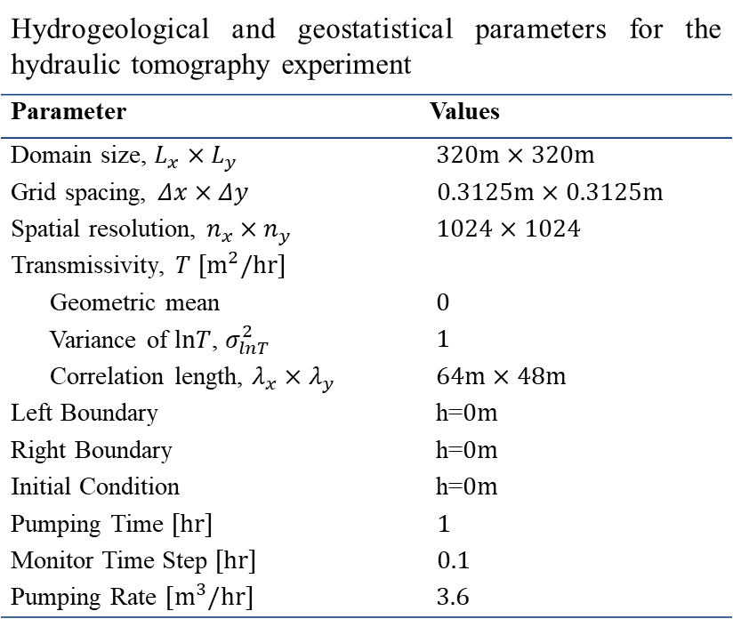
Appendix – Experimental Domain
Hydrogeological and geostatistical parameters for the hydraulic tomography experiment
Parameter | Values
Domain size, $L_{x}×L_{y}$ | $320m×320m$
Grid spacing, $Δx×Δy$ | $0.3125m×0.3125m$
Spatial resolution, $n_{x}×n_{y}$ | $1024×1024$
Transmissivity, $T [m^{2}/hr]$
Geometric mean | $0$
Variance of $lnT$, $σ_{lnT}^{2}$ | $1$
Correlation length, $λ_{x}×λ_{y}$ | $64m×48m$
Left Boundary | h=$0m$
Right Boundary | h=$0m$
Initial Condition | h=$0m$
Pumping Time $[hr]$ | $1$
Monitor Time Step $[hr]$ | $0.1$
Pumping Rate $[m^{3}/hr]$ | $3.6$

Slide 19
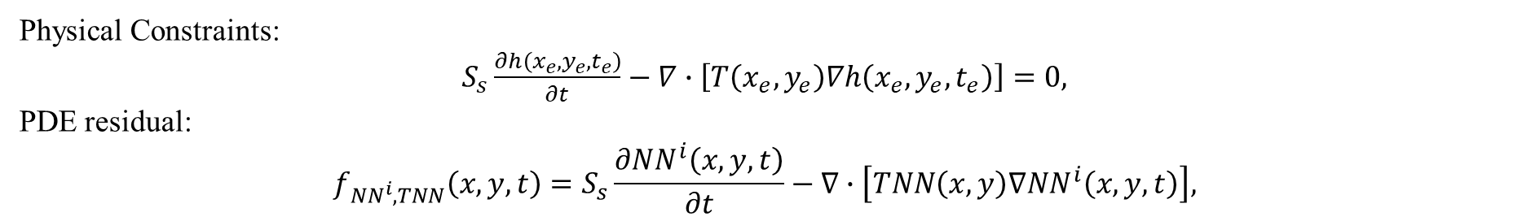
Appendix – PDE Loss
Physical Constraints:
$S_{s}\frac{∂h\left(x_{e},y_{e},t_{e}\right)}{∂t}−∇∙\left[T\left(x_{e},y_{e}\right)∇h\left(x_{e},y_{e},t_{e}\right)\right]=0,$
PDE residual:
$$f_{NN^{i},TNN}\left(x,y,t\right)=S_{s}\frac{∂NN^{i}\left(x,y,t\right)}{∂t}−∇∙\left[TNN\left(x,y\right)∇NN^{i}\left(x,y,t\right)\right],$$
PDE for non-pumping grid:
$$Loss_{e}=\frac{1}{N_{e}}\sum_{j=1}^{N_{e}}{{\left|f_{NN,TNN}\left(x_{e}^{j},y_{e}^{j},t_{e}^{j}\right)\right|}^{2}}$$
PDE for pumping grid:
$$Loss_{p}=\frac{1}{N_{p}}\sum_{j=1}^{N_{p}}{{\left|f_{NN,TNN}\left(x_{p}^{j},y_{p}^{j},t_{p}^{j}\right)−Q_{p}\right|}^{2}}$$

Slide 20
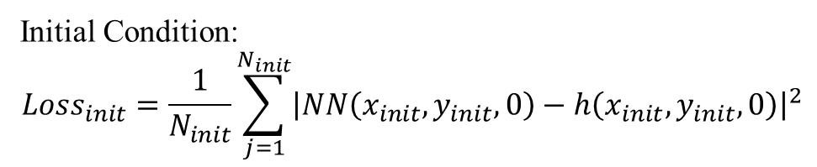
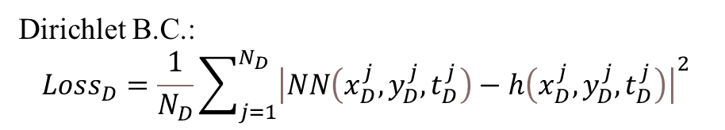
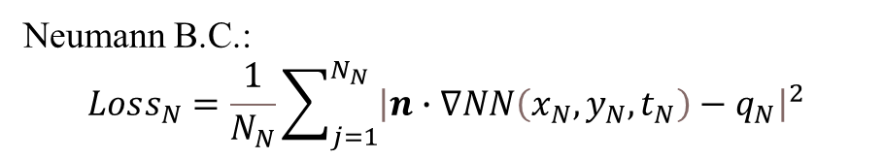
Appendix – B.C and I.C Loss
Dirichlet B.C.:
$$Loss_{D}=\frac{1}{N_{D}}\sum_{j=1}^{N_{D}}{{\left|NN\left(x_{D}^{j}, y_{D}^{j},t_{D}^{j}\right)−h\left(x_{D}^{j}, y_{D}^{j},t_{D}^{j}\right)\right|}^{2}}$$
Neumann B.C.:
$$Loss_{N}=\frac{1}{N_{N}}\sum_{j=1}^{N_{N}}{{\left|n∙∇NN\left(x_{N}, y_{N},t_{N}\right)−q_{N}\right|}^{2}}$$
Initial Condition:
$$Loss_{init}=\frac{1}{N_{init}}\sum_{j=1}^{N_{init}}{{\left|NN\left(x_{init},y_{init},0\right)−h\left(x_{init},y_{init},0\right)\right|}^{2}}$$

Slide 21
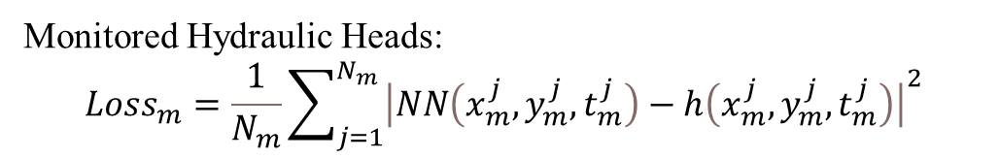

Appendix – Data Match Loss
Monitored Hydraulic Heads:
$$Loss_{m}=\frac{1}{N_{m}}\sum_{j=1}^{N_{m}}{{\left|NN\left(x_{m}^{j}, y_{m}^{j},t_{m}^{j}\right)−h\left(x_{m}^{j}, y_{m}^{j},t_{m}^{j}\right)\right|}^{2}}$$
Measured Transmissivity:
$$Loss_{T}=\frac{1}{N_{T}}\sum_{j=1}^{N_{T}}{{\left|TNN\left(x_{T}^{j}, y_{T}^{j}\right)−T\left(x_{T}^{j}, y_{T}^{j}\right)\right|}^{2}}$$

Slide 22

Appendix – Loss Function
$$Loss_{NN}=λ_{m}Loss_{m}+λ_{e}Loss_{e}+λ_{N}Loss_{N}+λ_{D}Loss_{D}+λ_{p}Loss_{p}+λ_{init}Loss_{init}$$
$$Loss_{HT−PINN}=\sum_{i=1,2,…n}{Loss_{NN}^{i}}+λ_{T}Loss_{T}$$
$λ_{m}={10}^{4}$, $λ_{f}=50$, $λ_{p}=1$, $λ_{N}={10}^{4}$, $λ_{D}={2×10}^{4}$, $λ_{T}={10}^{3}$, $λ_{init}={10}^{4}$

Slide 23



Appendix – Evaluation Met
Relative residuals:
$$ε_{NN^{i}}=\frac{{\left\|NN^{i}\left(x,y,t\right)−h^{i}\left(x,y,t\right)\right\|}_{2}^{2}}{{\left\|h^{i}\left(x,y,t\right)\right\|}_{2}^{2}}, \left(x,y\right)∈Ω, t∈(0,T]$$
$$ε_{T}=\frac{{\left\|TNN\left(x,y\right)−T\left(x,y\right)\right\|}_{2}^{2}}{{\left\|T\left(x,y\right)\right\|}_{2}^{2}}, \left(x,y\right)∈Ω$$
Inverse accuracy:
$$ε\left(x,y\right)=\frac{\left|TNN\left(x,y\right)−T\left(x,y\right)\right|}{T^{max}−T^{min}}, \left(x,y\right)∈Ω$$
Accuracy = percent of grids with $ε\left(x,y\right)<10\%$

Slide 24
Appendix – Training Implementation
5 forward networks + 1 inverse network are trained together.
Reference data are corrupted with 5% white noises.
Input and output variables are normalized.
Different loss terms are weighted to similar magnitude.
Each training iteration takes a batch of data to feed HT-PINN.
Each epoch has 50 iterations for steady-state and 500 iterations for transient HT.
HT-PINN is trained for 3000 epochs with Adam optimizer.
Learning rate = 10⁻³ for 1-1000, 10⁻⁴ for 1000-2000, 10⁻⁵ for 2000-3000.
Training hardwares are Google Colab GPU

